Slide 1
Fundamentals of Software Engineering
LECTURE 15: Software Architecture

Slide 2
Software Architecture
Is the description of elements from which system is built, interaction among those elements, patterns that guide their composition, and constraints on the patterns.
Considers system as a collection of components and their interactions

Slide 3
Components and their interactions
Components are such things as clients and servers, databases, layers, etc.
Interactions among components can be procedure calls, shared variable access, etc.
At the architectural level, we also consider system-level issues as capacity, consistency, performance, etc.

Slide 4
Software Architecture
The fundamental organization of a system embodied in its components, their relationships to each other, and to the environment, and the principles guiding its design and evolution.

Slide 5
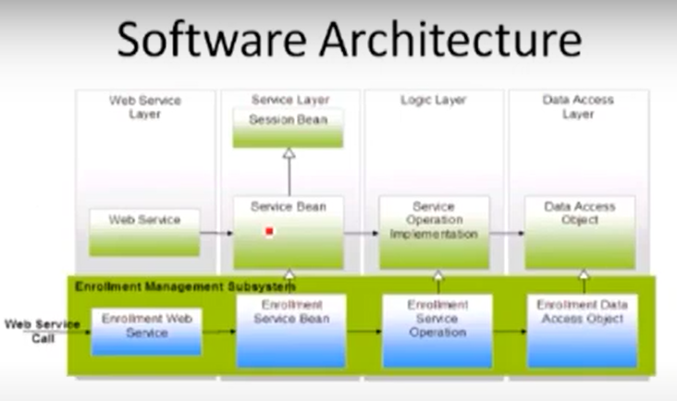

Slide 6
Software Architecture
What is the nature of the elements?
What are the responsibilities of the elements?
What is the significance of connections?
What is the significance of layers?

Slide 7
Where does the architecture design comes from?
The architecture design representation is derived from the system requirement specification and the analysis model.

Slide 8
Why is software architecture design so important
A poor design may result in a deficient product that
Does not meet system requirements,
Is not adaptive to future requirement changes,
Is not reusable,
Exhibits unpredictable behavior or perform badly

Slide 9
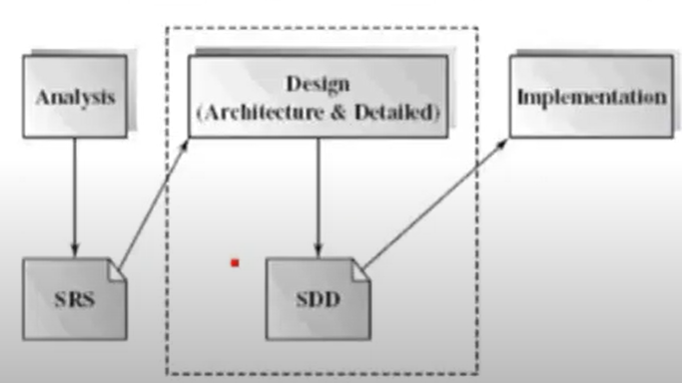
When is software designed conducted
Software design is an early phase of the software development life cycle

Slide 10
What is the outcome of the software architecture design?
Simply put, it is an overall representation of the software to be built.
A complete software architecture specification must describe not only
The elements and connectors between elements, but also the
Constraints and runtime behaviors
So that developers knows what and how the design should be implemented

Slide 11
Architecture vs.Design
All architecture is design, not all design is architecture
Architectural design is outward looking
Focus on stakeholders, not technology
Architecture doesn’t describe the complete characteristics of components ,design does.

Slide 12
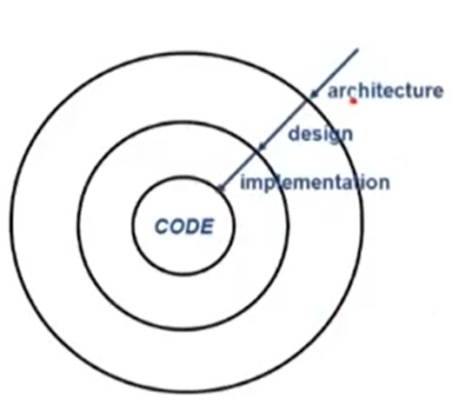

Slide 13
Architectural influences
Influences
System stakeholders
Developing organization
Architects background and experiences
Technical environment
Precautionary measures
Know your constraints
Early engagement of stakeholders

Slide 14
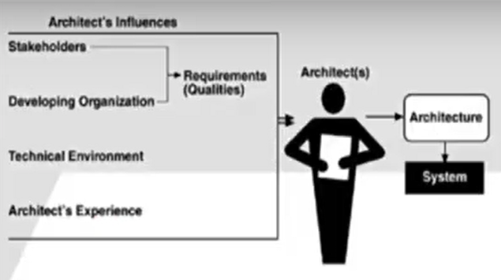

Slide 15
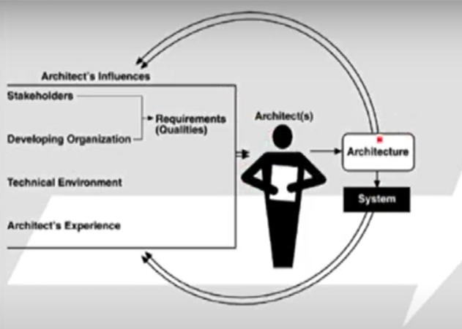

Slide 16
An Architect’s Task
Perform static partition and decomposition of a system into sub systems and communications among subsystems.
A software element can be configured, delivered, developed, and is replaceable in the future.
Each elements interface encapsulates details and provide loose coupling with other elements or subsystems.

Slide 17
An Architect’s Task
Establish dynamic control relationships among different subsystems in term of data flow, control flow, or message dispatching
Consider and evaluate alternative architecture styles that suits the problem domain at hand.

Slide 18
An Architect’s Task
Perform tradeoff analysis on quality attributes and other non functional requirements during the selection of architecture styles.
For example, in order to increase a distributed system’s extensibility, portability, or maintainability, software components and web services may be the best choice of element types, and a loose connection among these elements may be most appropriate.

Slide 19
Architecture Business Cycle(ABC)
Software architecture is a result of technical, business and social influences
These are in turn affected by the software architecture itself.
This cycle of influences from the environment to the architecture and back to the environment is called the architecture business cycle (ABC)

Slide 20
ABC Activities
Creating the business case for the system
Why we need a new system, what will b its cost?
Time to market, integration with exiting system?
Understanding the requirements
Various approaches for requirements elicitation i.e, object oriented approach, prototyping etc
The desired qualities of a system shape the architectural decesions-architecture defines the tradeoffs among requirements

Slide 21
ABC Activities
Creating/selecting the architecture
Communicating the architecture
Inform all stakeholders (developers, testers, managers, etc. )
Architecture's documentation should be unambiguous
Analyzing or evaluating the architecture
Evaluate candidate designs
Architecture maps the stakeholder’s requirements

Slide 22
ABC Activities
Implementation based on architecture

